Slide 1

SIT112 Workshop week 2

Slide 2
contents
Introduction to Python
- Part 2
3
Lecture Week 1 Recap
1
Task P1
2

Slide 3
directions
The tutors help you recap the contents of Lecture Week 1
We continue on "Introduction to Python"
Let’s begin ...
The tutors will help you clarify any questions about the assessment guideline and task P1

Slide 4
Lecture week 1 recap
The tutor will quickly take you through the examples in lecture 1.
You can ask questions if you need further clarification.

Slide 5
Task p1 : assessment guideline
Read the assessment guideline carefully.
Clarify any questions with the tutors.
Sign the assessment guideline (Task P1) and submit it on OnTrack as instructed at the end of the document.
Make sure you have understood how to choose your target grade. Also, note you can change your target grade at any point ☺
The following video may help you set a realistic target for yourself in this unit …

Slide 6
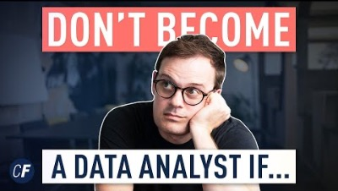

Slide 7
Introduction to Python – Part 2
Please open the attached Notebook in Jupyter Lab and follow the instructions.

Slide 8
Learn more
https://www.programiz.com/python-programming/examples
https://www.w3schools.com/python/

